Slide 1
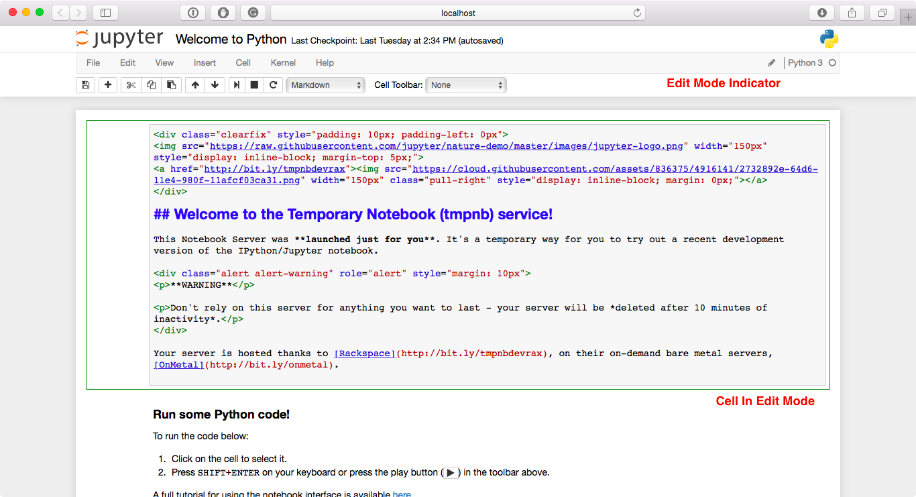
Jupyter Notebook: User Interface Components
When a cell is in edit mode, the Cell Mode Indicator will change to reflect the cell’s state. This state is indicated by a small pencil icon on the top right of the interface. When the cell is in command mode, there is no icon in that location.

Slide 2
Jupyter Notebook: User Interface Components
Text can be added using Markdown cells. You can change the cell type to Markdown by using the Cell menu, the toolbar, or the key shortcut m. Markdown is a popular markup language that is a superset of HTML. Its specification can be found here: https://daringfireball.net/projects/markdown/

Slide 3
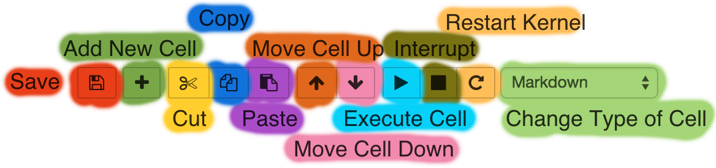
Jupyter Notebook: User Interface Components
Toolbar and Commands
Shift + Enter Execute cell and jump to the next cell
Ctrl + Enter Execute cell and don’t jump to the next cell
If code execution is not responding anymore: Restart kernel (cache of previously assigned variables gets emptied)

Slide 4
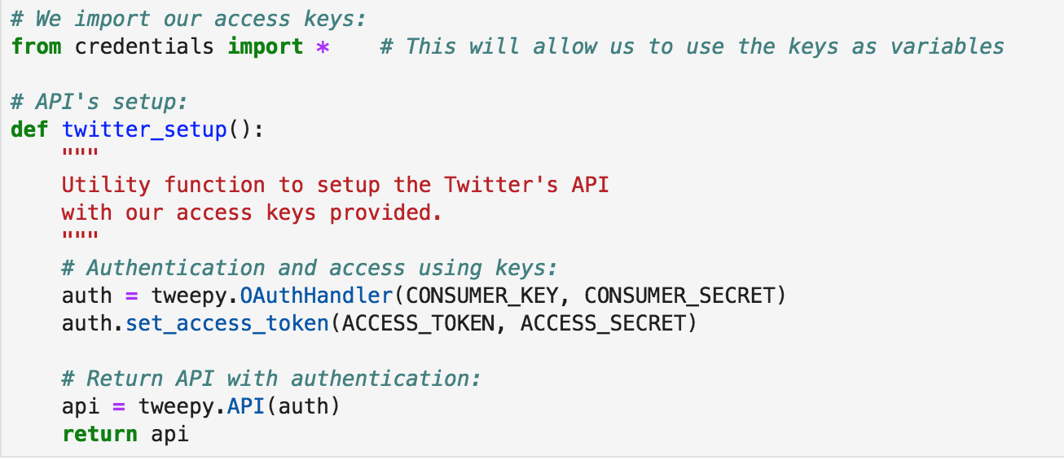
Twitter –Extracting twitter data (tweepy + pandas)
Connect your twitter API to twitter.
Add the following code to our TweetsExt Notebook file.
Hit run.
Notes:
def TWITTER_SETUP():
auth = tweepy.OAuthHandler(CONSUMER_KEY, CONSUMER_SECRET)
auth.set_access_token(ACCESS_TOKEN, ACCESS_SECRET)
# Obtain authenticated API
api = tweepy.API(auth)
return api

Slide 5
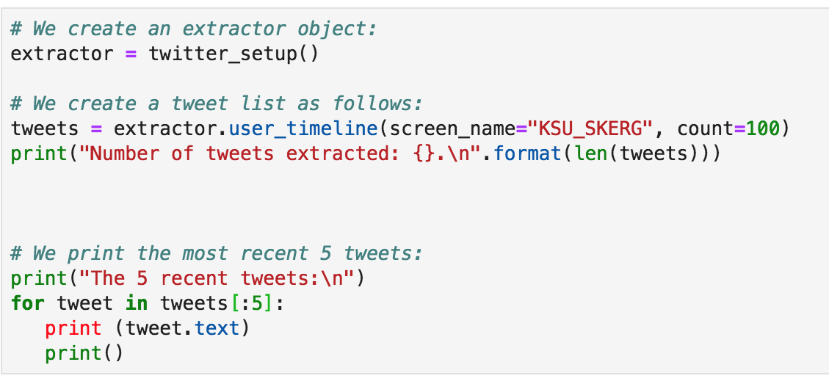
Twitter –Extracting twitter data (tweepy + pandas)
Extract the tweets.
Add the following code to our TweetsExt Notebook file.
Hit run.
Notes:
extractor = TWITTER_SETUP()
tweets = extractor.user_timeline(screen_name="KSU_SKERG", count=10)
print("number of extracted tweets: {}.\n".format(len(tweets)) )
for tweet in tweets[:5]:
print(tweet.text+"\n")

Slide 6
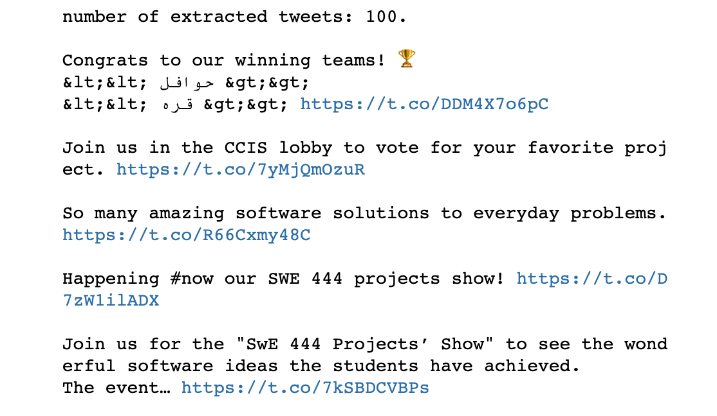
Twitter –Extracting twitter data (tweepy + pandas)
Extract the tweets:

Slide 7
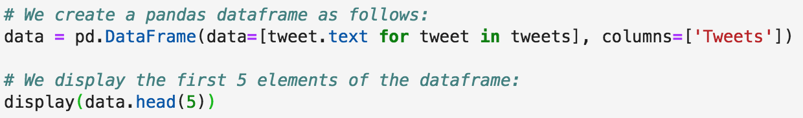
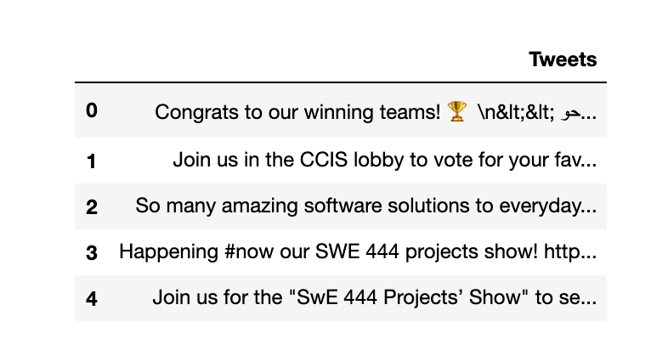
Twitter –Extracting twitter data (tweepy + pandas)
Show the tweets in a table .
Add the following code to our TweetsExt file
Hit run.
Notes:
Two-dimensional size-mutable, potentially heterogeneous tabular data structure with labeled axes (rows and columns).
data = pd.DataFrame(data=[tweet.text for tweet in tweets], columns=['Tweets'])
data['len'] = np.array([len(tweet.text) for tweet in tweets])
data['ID'] = np.array([tweet.id for tweet in tweets])
data['Date'] = np.array([tweet.created_at for tweet in tweets])
data['Source'] = np.array([tweet.source for tweet in tweets])
data['Likes'] = np.array([tweet.favorite_count for tweet in tweets])
data['RTs'] = np.array([tweet.retweet_count for tweet in tweets])
# Display of first 10 elements from DataFrame
display(data.head(5))

Slide 8
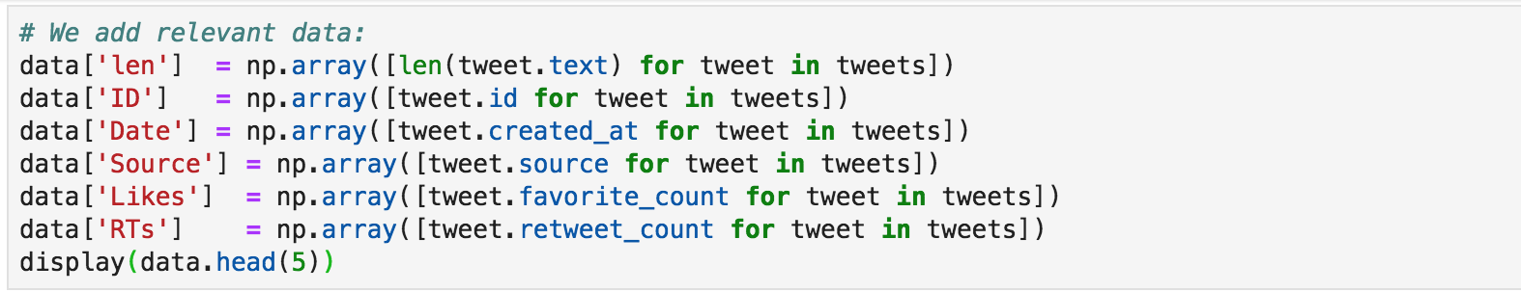
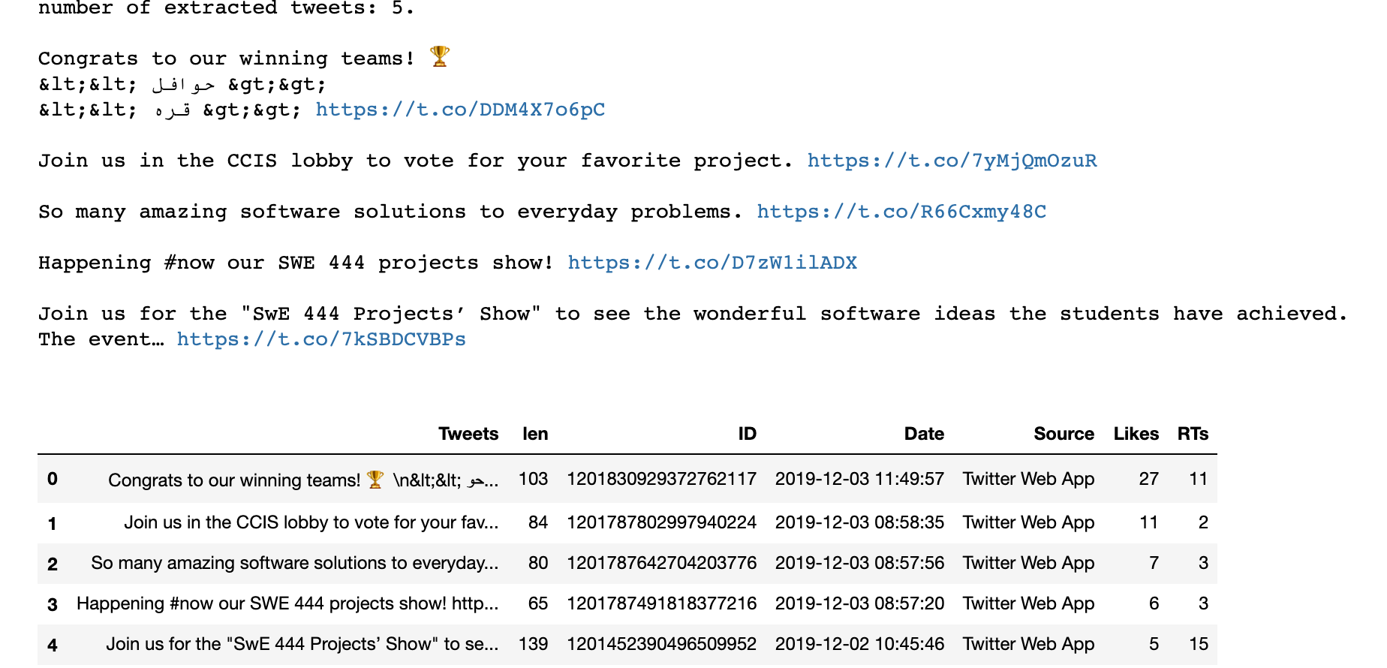
Twitter –Extracting twitter data (tweepy + pandas)
Show more details of the tweets in a table .
Add the following code to our TweetsExt file.
Hit run.
Notes:
this we will use Pythons list comprehension and a new column will be added to the dataframe by just simply adding the name of the content between square brackets and assign the content.

Slide 9
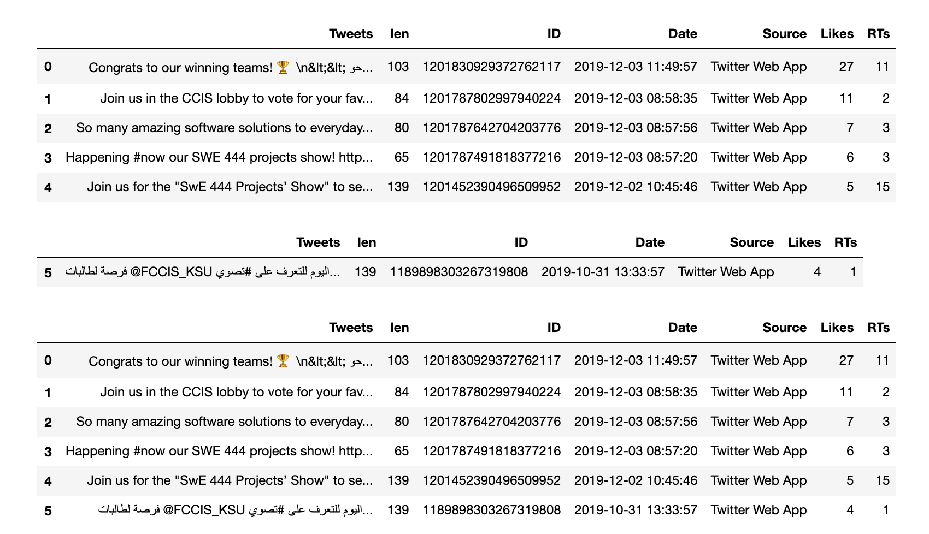
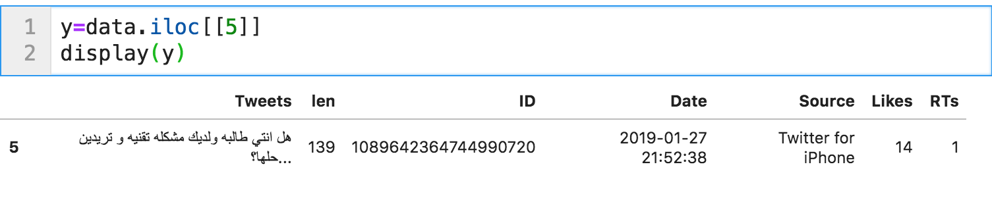
Twitter –Extracting twitter data (tweepy + pandas)
Show specific tweet row details in a table .
Add the following code to our TweetsExt file and hit run.
Notes:
this we will use Pythons list comprehension and a new column will be added to the dataframe by just simply adding the name of the content between square brackets and assign the content.

Slide 10
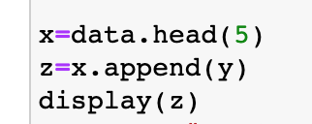
Twitter –Extracting twitter data (tweepy + pandas)
Append a specific row to dataframe.
Add the following code to our TweetsExt file to save the tweets in a CSV file. and hit run.
Notes:
Save tweets to csv file ref: https://stackoverflow.com/questions/16923281/pandas-writing-dataframe-to-csv-file
Save tweets to txt file: https://stackoverflow.com/questions/28130124/how-to-save-a-tweepy-twitter-stream-to-a-file (Didn’t try it)

Slide 11
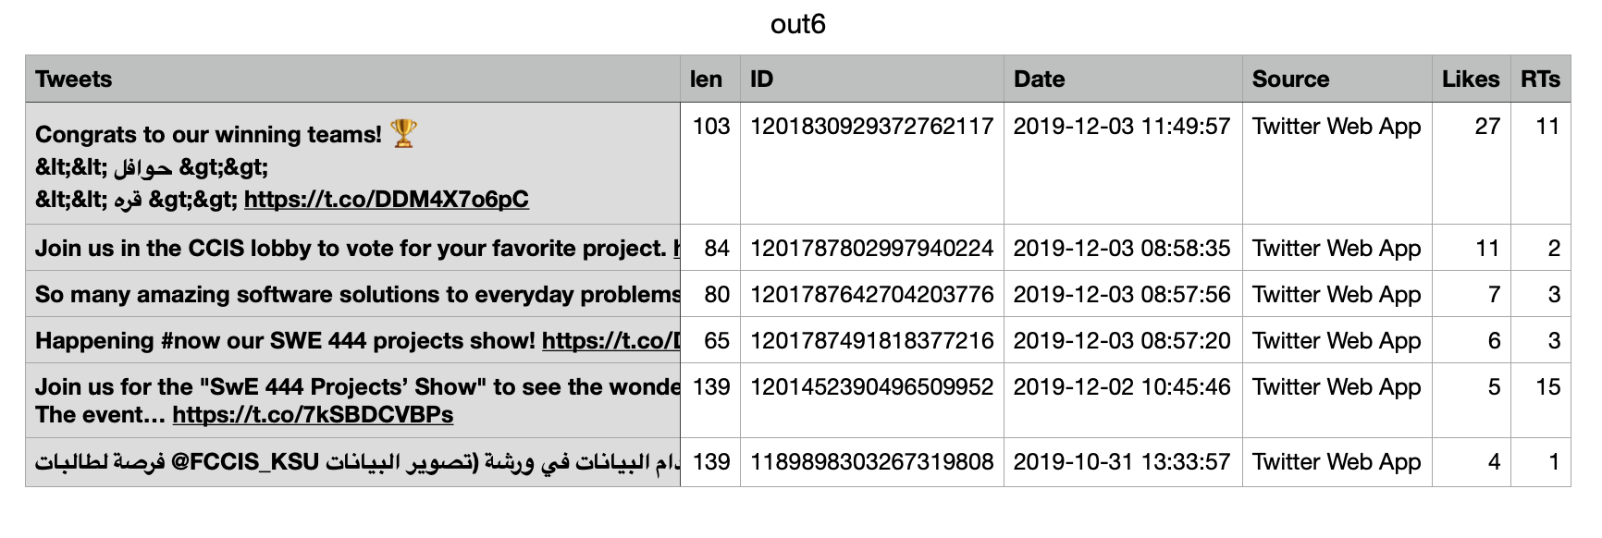
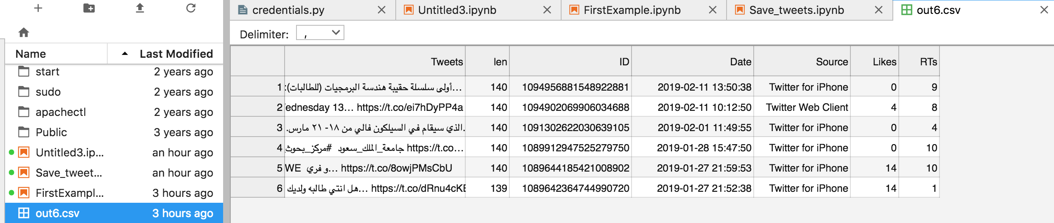
Twitter –Extracting twitter data (tweepy + pandas)
Save tweets to .csv file.
Add the following code to our TweetsExt file to save the tweets in a CSV file. and hit run.
You will find it in the Jupyter Files
Notes:
Save tweets to csv file ref: https://stackoverflow.com/questions/16923281/pandas-writing-dataframe-to-csv-file
Save tweets to txt file: https://stackoverflow.com/questions/28130124/how-to-save-a-tweepy-twitter-stream-to-a-file (Didn’t try it)

Slide 12
Rate Limit
It is primarily on a per-user basis — or more accurately described, per user access token. If a method allows for 15 requests per rate limit window, then it allows 15 requests per window per access token.
What happens if I hit a limit?
An error message appears telling you which limit you've hit. For limits that are time-based (like the Direct Messages, Tweets, changes to account email, and API request limits), you'll be able to try again after the time limit has elapsed. The Tweet limit of 2,400 updates per day is further broken down into semi-hourly intervals. If you hit your account update/Tweet limit, please try again in a few hours after the limit period has elapsed.
https://developer.twitter.com/en/docs/basics/rate-limiting
https://developer.twitter.com/en/docs/basics/rate-limits

